Slide 1
Final System presentation
Nolan Luckett
05/15/18

Slide 2
Introduction
GUI on the host PC
Serial data communication with the host PC

Slide 3
Host GUI
Displays audio data and messages received from the Zybo board.

Slide 4
Tools
GUI created with Python, JavaScript, and HTML/CSS
Python is used as the backend code for serial communication and data processing
JavaScript is used for dynamic GUI behaviors (plotting, list updates)
HTML/CSS is used for designing the UI

Slide 5
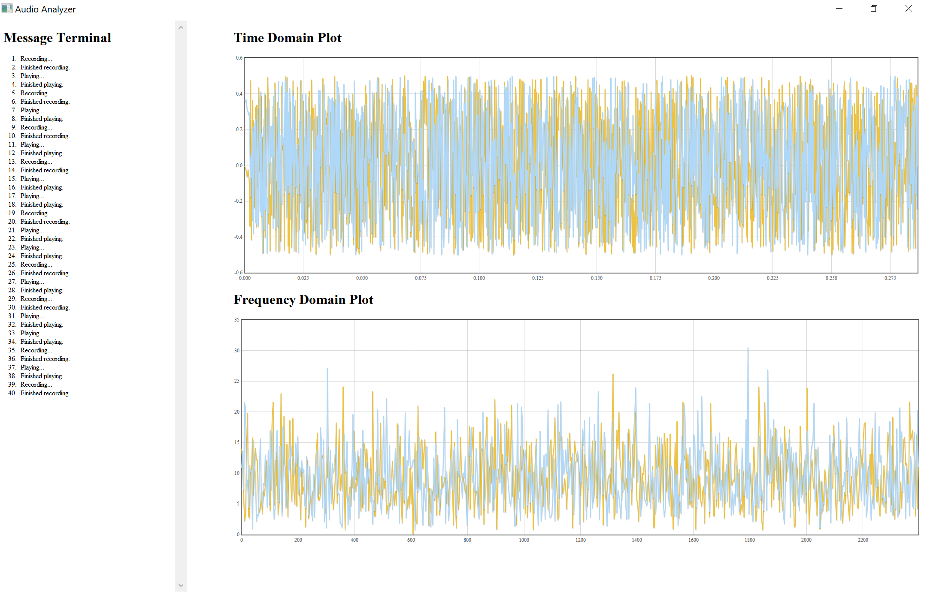
Host GUI
The host GUI has three panels
Message Terminal
Time Domain Plot
Frequency Domain Plot

Slide 6
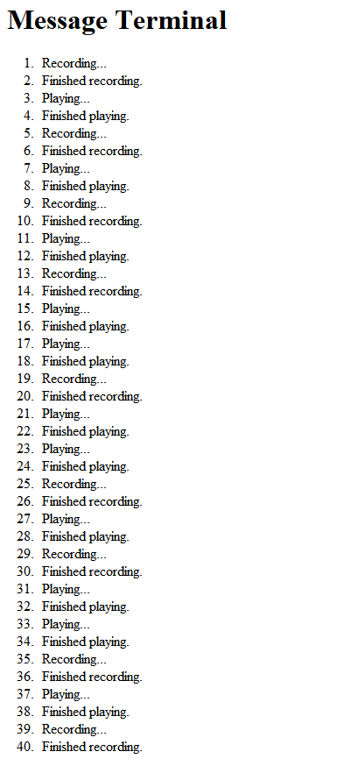
Message terminal
Show messages received from the Zybo board
Scrolls when the log is full

Slide 7
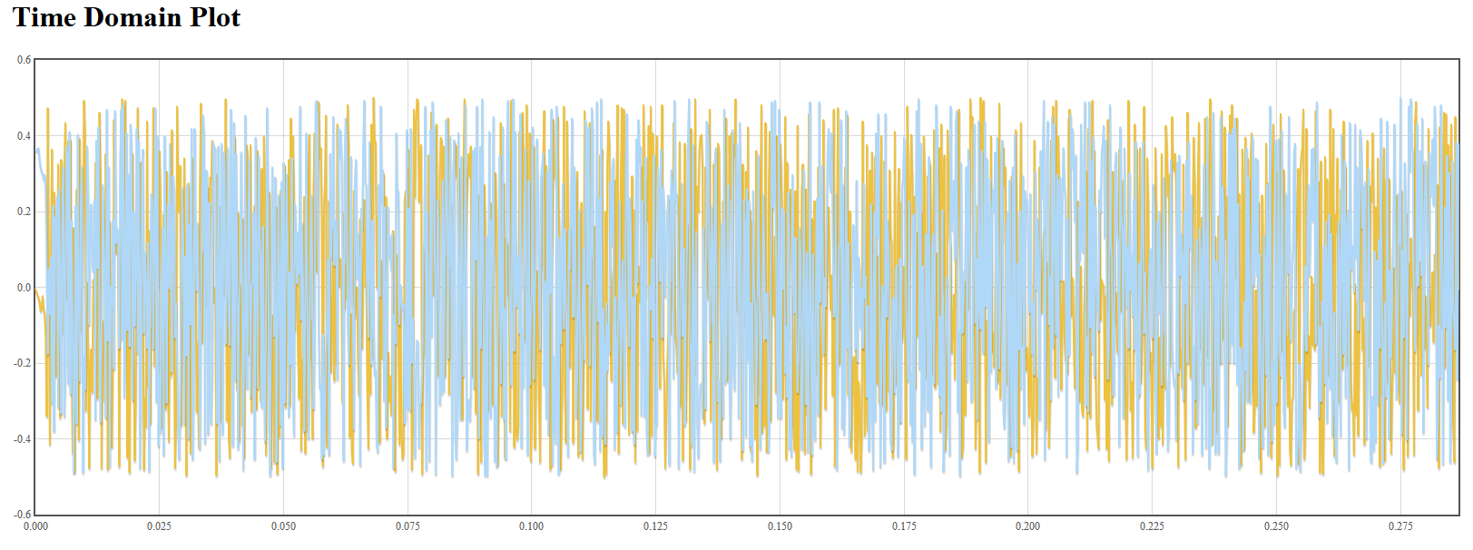
Time domain plot
Shows audio data recorded in the time domain
Units are volts vs. seconds
Plotting is performed on the host PC

Slide 8
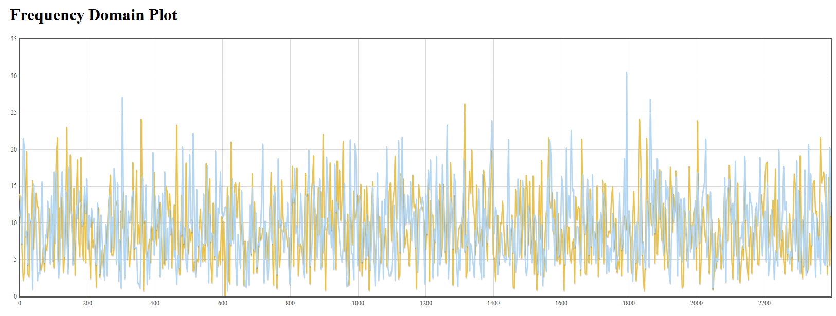
Frequency domain plot
Show Fast Fourier Fransformed audio data
FFT is performed on the host PC to reduce data transfer time

Slide 9
Serial communication
Serial messages were formatted with JSON.

Slide 10
JSON
JavaScript Object Notation
Converts language structures into strings
Example:
var a = [1, 2, 3];
var s = JSON.stringify(a);
“s” is now the string “[1, 2, 3]”

Slide 11
Message format
All messages are categorized as dictionaries of three types based on the outermost key
{“data” : …}
{“message” : …}
{“error” : …}

Slide 12
Message parsing
Because serial data is streamed, it is necessary to buffer data and wait until a complete message is received.
Messages are separated based on the occurrence of the token “}{“

